Slide 1
GMO Answers
WE WANT TO DO A BETTER JOB ANSWERING YOUR QUESTIONS
Notes:
This PowerPoint was developed to be a resource for you. Our goal is to help you communicate about GMOs in an easy-to-understand and transparent way. We designed this presentation for you with this in mind.
The first section of the presentation provides background information on GMOAnswers.com – who we are, what we do and the resources we provide. The second section covers key topic areas highlighting the science behind GMOs – GMO Basics, GMOs & You, GMOs & the Environment, Modern Agriculture
Please feel free to tailor the presentation for your audience and specific needs. We hope this guide will help you when communicating about GMOs.

Slide 2

What is GMO Answers?
GMO Answers is an initiative committed to responding to your questions about how food is grown. Its goal is to make information about GMOs in food and agriculture easier to access and understand.
Join us. Ask tough questions. Be skeptical. Be open. We look forward to sharing answers.
GMOAnswers.com
Notes:
GMO Answers was created to do a better job answering consumers’ questions — no matter what they are — about GMOs. The biotech industry stands 100 percent behind the health and safety of the GM crops on the market today, but we acknowledge that we haven’t done the best job communicating about them – what they are, how they are made and what the safety data says. GMO Answers is the beginning of a new conversation among everyone who cares about how our food is grown.
GMO Answers represents a shift in how we communicate about agriculture. Instead of repeating just the facts and science, we must acknowledge the skepticism; show that we’re listening; and respond to questions and concerns in an open, transparent, direct and conversational manner.
GMO Answers is sponsored by the members of the Council for Biotechnology Information: BASF, Bayer CropScience, Dow AgroSciences, DuPont Pioneer, Monsanto Company & Syngenta.

Slide 3
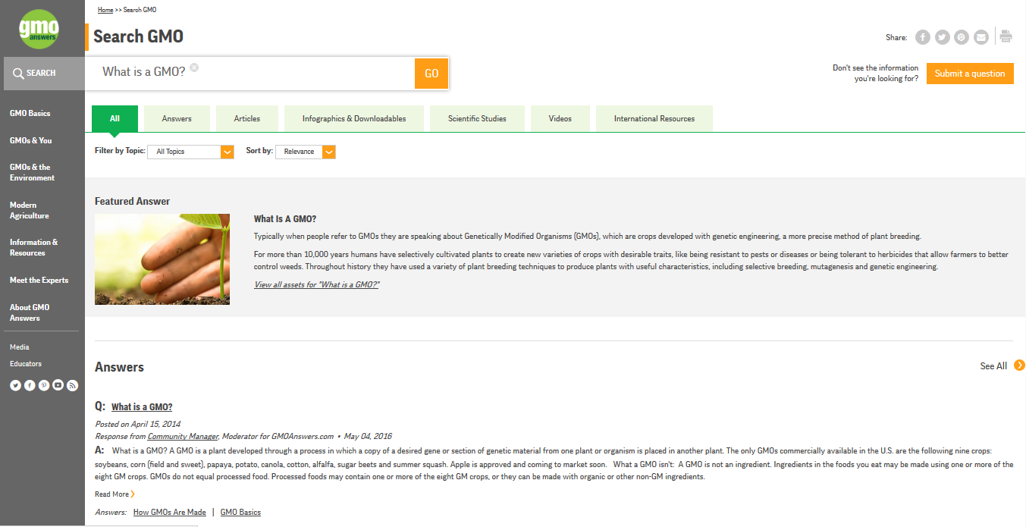
Answering Consumers’ Questions
Notes:
Our website, GMOAnswers.com, is a direct pipeline for consumers to receive answers to their questions about GMOs, agriculture and how our food is grown. To date we’ve provided hundreds of answers. The GMO Answers team works with over 200 volunteer, independent and company experts to directly respond to consumer questions.

Slide 4
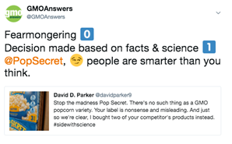
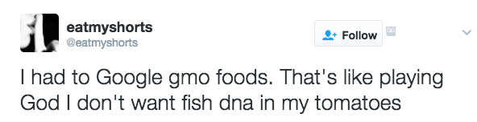
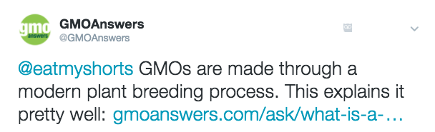
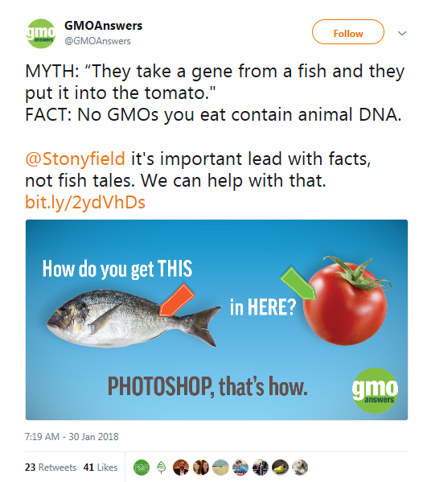

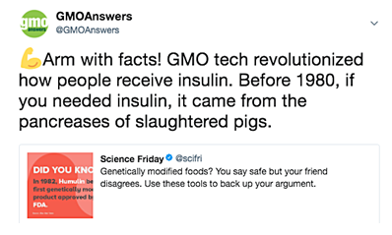
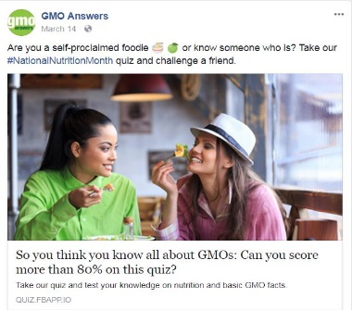



Engaging in Online Conversation
1:1 Social Engagement
Myth-busting
Notes:
The GMO Answers team also leverages several social media channels to engage with consumers and direct them to expert responses on GMOAnswers.com that may address some of their questions. Our audience is a mix of pro-GMO, anti-GMO and those in the middle searching for more information.
We use Twitter and Facebook to tap into relevant conversations, engage with our audience, and broadcast interesting and thought-provoking information about GMOs and biotechnology.
We directly engage in dialogue with our audience on social media to debunk common GMO myths and anti-scientific claims. We tap into conversation triggers that warrant factual input, utilizing our existing educational resources.
In addition, YouTube and Pinterest are used to share visual GMO information to help counter inaccurate information that’s shared online.

Slide 5
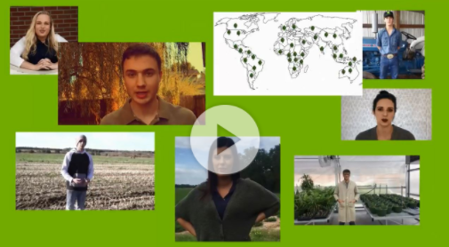
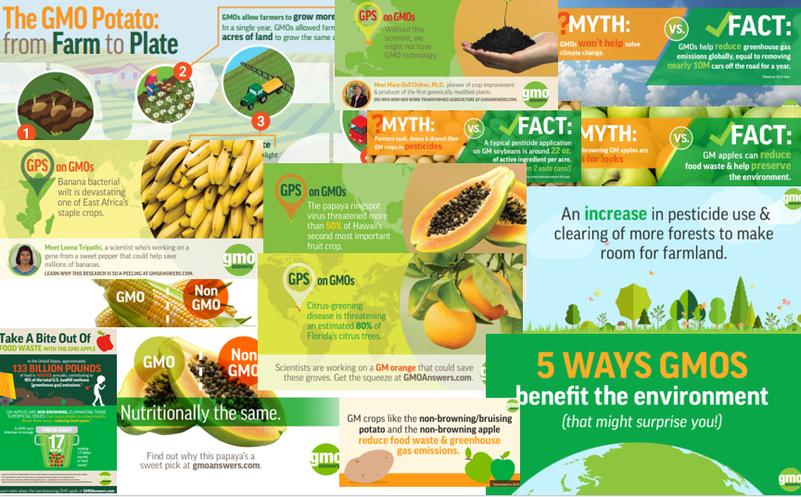
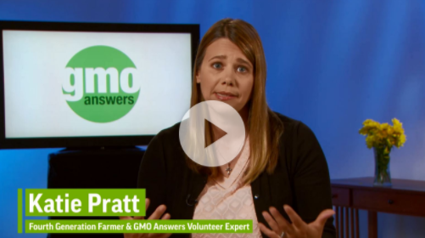

Resources: Educational Content
Notes:
GMO Answers is a rich resource for information about GMOs and biotechnology in agriculture. Our educational resources page has materials that can be downloaded, printed and shared. Go to www.GMOAnswers.com/information-and-resources/infographics-and-downloadables.
GMO Answers has created informational videos that can be viewed on www.GMOAnswers.com/information-and-resources/video and on our YouTube page - www.youtube.com/channel/UCyuFNJ7qwgFiZudgwd891DA

Slide 6

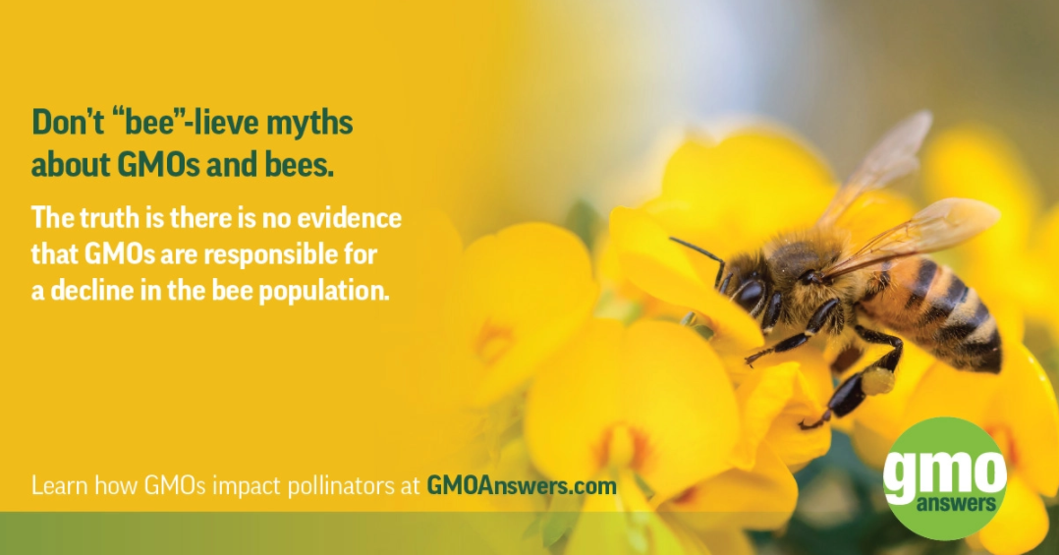
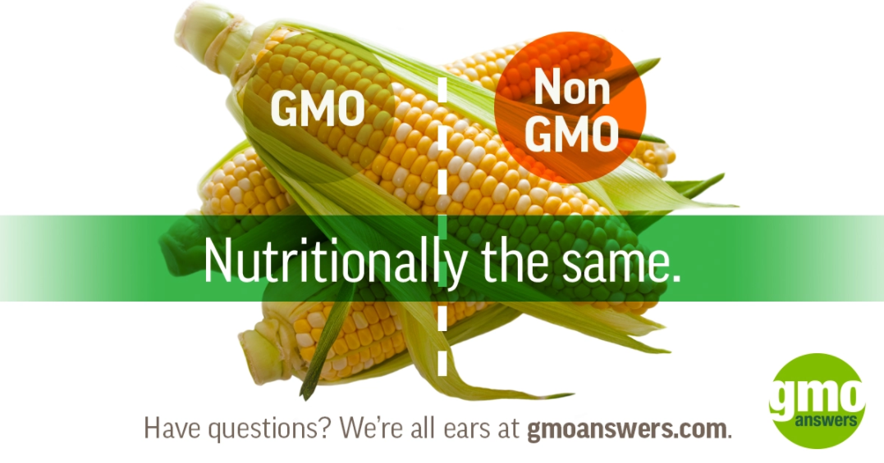

Resources: Educational Content Cont.
Notes:
We’ve developed visual myth-busters, which are simple, bright, bold images that tackle myths and misconceptions about GMOs. These purposely contain small amounts of information so that viewers can take in the information in a just few seconds. In sharing and promoting these graphics, we direct viewers to GMOAnswer.com for more information and encourage them to submit additional questions. Visual myth-busters are designed to tackle long-standing misinformation or address the latest viral GMO meme.

Slide 7
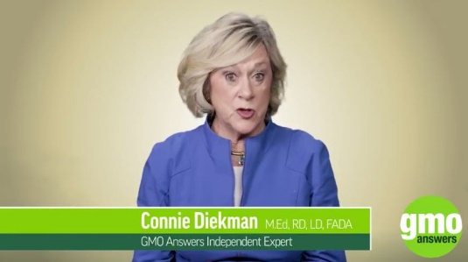

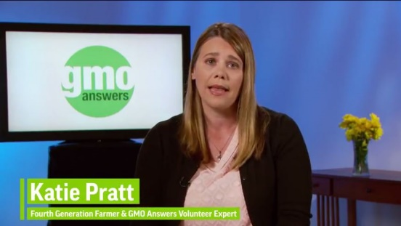



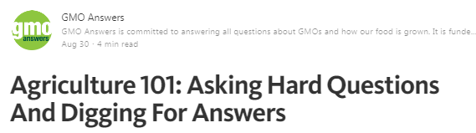
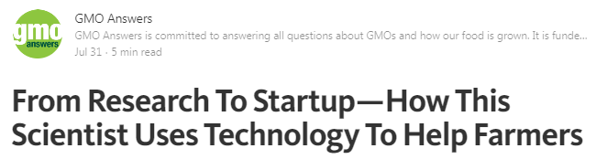
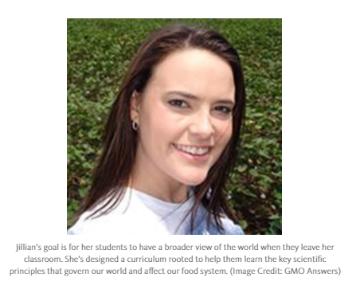

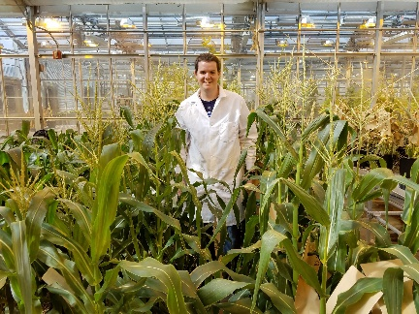
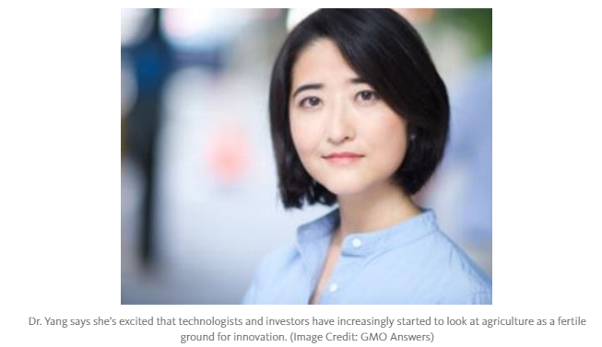
Meet Our Experts
GMO Answers is committed to finding the best expert to answer your question. Depending on the nature of your question, the answer may be provided by an independent expert, industry organization, the GMO Answers Community Manager or an expert from a member company.
Notes:
Independent Experts
GMOAnswers.com will solicit feedback from experts across a wide range of disciplines in order to provide consumers with balanced, fact-based responses to their questions. The expert resources we’ve identified include conventional and organic farmers, agribusiness experts, scientists, academics, medical doctors and nutritionists from a wide range of studies. These are the leaders in their fields, respected for their subject matter expertise and their unique insights. They are not affiliated with the Council for Biotechnology Information or its member companies, but have volunteered to address questions because they believe in transparency and consumers’ rights to make informed choices about the food they serve to their families
Company Experts
GMO Answers works with a number of experts from the biotechnology companies who founded GMO Answers to address your questions. These company experts are sourced from a range of disciplines, from toxicology to public affairs to weed management, to answer questions related to their expertise. They also address questions about their company products and practices.
Ambassador Experts
GMO Answers Ambassadors are a group of experts working in biotechnology, genetic engineering, health and nutrition, public policy and beyond. They share one thing in common: a passion for connecting with the public on important topics surrounding food production. Together, they comprise a community of highly engaged experts who can talk about GMOs and answer questions about how our food is produced.
GMO Answers Ambassadors engage the public by sharing their stories, research and perspectives on GMOs and food production with media and at speaking engagements. Ambassadors have the opportunity to attend—and often present at—industry conventions and meetings, and participate in panel discussions and other related events.

Slide 8
Get to Know GMOs

Slide 9
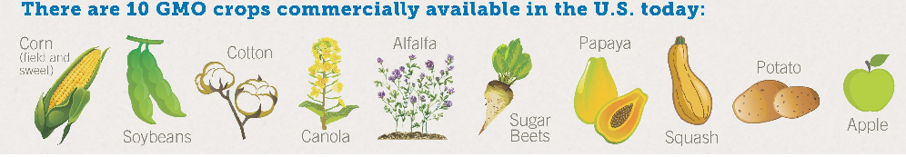
GMO Basics
GMOs are crops developed with genetic engineering, a more precise breeding technique, that enables someone to take individual traits found in nature and transfer them to another plant, or make changes to an existing trait in a plant.
Notes:
GMOs are crops developed with genetic engineering, a more precise breeding technique, that enables someone to take individual traits found in nature and transfer them to another plant, or make changes to an existing trait in a plant.
You may have also heard of “agricultural biotechnology” or “biotech seeds”. These are terms that may be used to refer to the same thing – a genetically modified organism (GMO).
The 10 genetically modified crops commercially available in the U.S. today are: alfalfa, apples, canola, corn (field and sweet), cotton, papaya, potatoes, soybeans, squash and sugar beets.

Slide 10
GMO Basics Cont.
Why Grow GMOs?
GMOs are created to achieve a desired trait, such as resistance to a pest or tolerance to drought conditions. The 10 genetically modified crops available today include: alfalfa, apples, canola, corn (field and sweet), cotton, papaya, potatoes, soybeans, squash and sugar beets. GM crops were created for:
Insect resistance. This category of traits provides farmers with season-long protection against target pests, reduces the need for pesticide applications, and lowers input costs.
Drought tolerance. GM crops that express drought tolerance have better moisture retention and can better endure drought conditions without the need for additional irrigation.
Herbicide tolerance. Crops developed to tolerate specific herbicides allow farmers to fight weeds by applying targeted herbicides only when needed and enable them to use conservation tillage production methods that preserve topsoil, prevent erosion, and reduce carbon emissions.
Disease resistance. Through genetic engineering plant breeders can enable plants to resist certain diseases, like the papaya ringspot virus (PRSV). The GM Rainbow Papaya, developed to be resistant to PRSV, allowed Hawaiian papaya farmers to recover from an outbreak of this devastating disease that crippled their industry.
Enhanced nutritional content. Genetically modified soybeans with an enhanced oil profile, much like olive oil, have been developed and are longer lasting and trans-fat free.
Reduced food waste. Genetic engineering has been used to modify potatoes and apples in order to eliminate superficial browning and bruising (potato only) when the produce is cut or handled. These traits can help reduce the amount of produce thrown away by producers, processors, retailers and consumers.
Improved manufacturing processes. Certain biotech corn varieties enable more efficient biofuels production by improving the process through which cellulose and/or starch is broken down and converted to fuel. This helps reduce the environmental impact of the manufacturing process by decreasing the amount of water, electricity, and natural gas needed to produce biofuel.

Slide 11
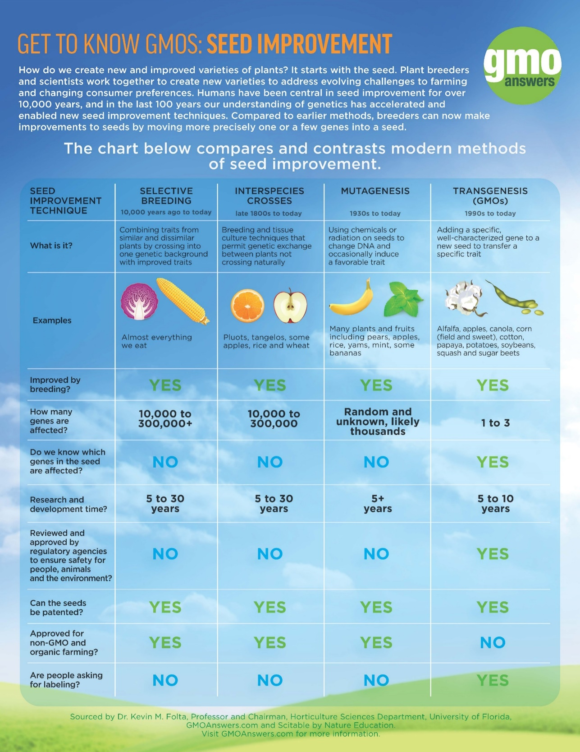
GMO Basics Cont.
This chart compares and contrasts modern methods of seed improvement.
How do we create new and improved varieties of plants? It starts with the seed. Plant breeders and scientists work together to create new varieties to address evolving challenges to farming and changing consumer preferences. Humans have been central in seed improvement for over 10,000 years, and in the last 100 years our understanding of genetics has accelerated and enabled new seed improvement techniques. Compared to earlier methods, breeders can now make improvements to seeds by moving more precisely one or a few genes into a seed.
Notes:
It is important to note that there are other methods of plant breeding beyond traditional breeding and genetic engineering which you can see in this infographic.
Here you’ll see different seed improvement techniques compared: selective (aka “traditional”) breeding, interspecies crosses, mutagenesis and transgenesis (GMO).
All of these techniques are used today.
Even though genetic engineering is a more precise breeding technique compared to the other three, only GMOs are required to go through regulatory approval before they are commercialized and are excluded from use in organic agriculture.

Slide 12

GMOs & You
How do we ensure that GMOs are safe for use
and consumption?
GMO crops are studied extensively to make sure they are safe for people, animals and the environment
GM seeds take an average of $136 million and 13 years to bring to market because of research, testing and regulatory approvals conducted by government agencies in the United States and around the world.¹
Notes:
How do we make sure that GMOs are safe for use and consumption?
Today’s GM products are the most researched and tested agricultural products in history.
GMO crops are studied extensively to make sure they are safe for people, animals and the environment
GM seeds take an average of $136 million and 13 years to bring to market because of research, testing and regulatory approvals conducted by government agencies in the United States and around the world.
In the U.S., GM crops are reviewed by at least USDA and FDA and sometimes EPA depending on the trait.

Slide 13
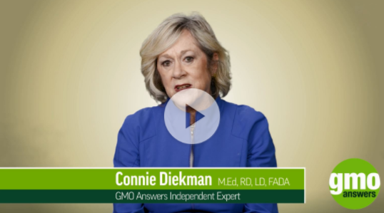





GMOs & You Cont.
GMO Safety
GMOs available today are as safe as their non-GMO counterparts.
They do not cause new allergies, cancer, infertility, ADHD, autism or any other diseases or conditions.
The safety of GMOs has been affirmed by:
Don’t believe us? Hear from GMO Answers volunteer expert and registered dietitian Connie Dikeman:
Notes:
That is the overwhelming consensus of scientific experts and major scientific authorities around the world, including the World Health Organization, United Nations Food and Agriculture Organization and American Medical Association. In fact, there have been more than 1,700 studies on the safety of GMOs, hundreds of which were independently funded.
In the spring of 2016, The National Academies of Science, Engineering and Medicine (NAS) researched this very same question and concluded: yes, GMOs are safe. A panel of more than 20 scientists, researchers, agricultural and industry experts reviewed over 20 years of data since GMOs were introduced, including nearly 900 studies and tests and European and North American health data and concluded – as other previous research concluded – that genetically modified crops are safe to eat, have the same nutrition and composition as non-genetically modified crops and have no links to new allergies, cancer, celiac or other diseases.

Slide 14

GMOs & the Environment
Between 1996 and 2015, crop biotechnology was responsible for an additional 180.3 million tons of soybeans, 357.7 million tons of corn, 25.2 million tons of cotton lint and 10.6 million tons of canola, without having to bring more land into production. To produce the same amount of crops without GM technology, farmers would have needed to cultivate 48 million additional acres of land.
In 2015, 58.9 billion pounds of atmospheric carbon dioxide emissions were reduced by conservation tillage and decreased fuel use made possible by genetically modified crops. That’s equal to removing nearly 12 million cars from roads for one year.
Notes:
Did you know that genetically modified crops can actually reduce the environmental impact of farming? And that GMOs can have other environmental benefits as well, such as helping to reduce food waste and improve air quality?
By making targeted improvements to crops through genetic engineering, farmers can raise more food for a growing world population while reducing agriculture’s impact on the environment.

Slide 15
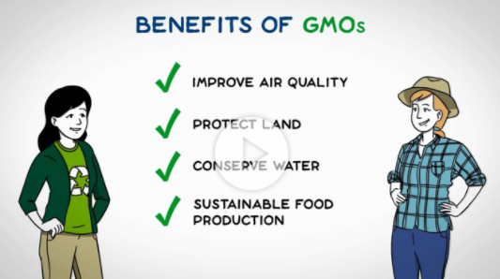
GMOs & the Environment Cont.
With an estimated world population of 9.7 billion by 2050, farmers will need to produce up to 70 percent more food than they do today to satisfy global demand. GMOs help farmers to use less land, fewer inputs and less energy while producing the food needed to meet this demand.
Learn more about the environmental benefit of GMOs here:

Slide 16
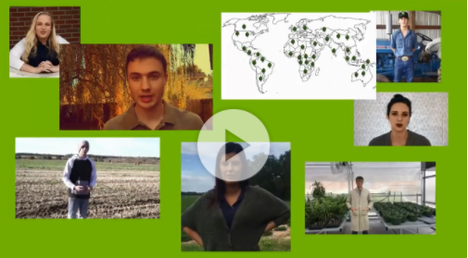
Modern Agriculture
See how some of today’s science enthusiasts would use biotechnology to tackle some of the world’s most pressing food challenges:
From GPS guided self-driving tractors to drones monitoring crop health, today’s modern farms use an array of innovative technologies to grow crops and utilize resources more efficiently than ever before. GMOs are one of modern agriculture’s many innovations and they are already allowing farmers to grow more food with fewer resources. GMOs are also contributing to innovations beyond the farm as well, including GMO crops that can help to reduce food waste, nutritionally enhanced GM crops that can help to alleviate under-nourishment around the world and new medicines that are being developed with genetic engineering.

Slide 17
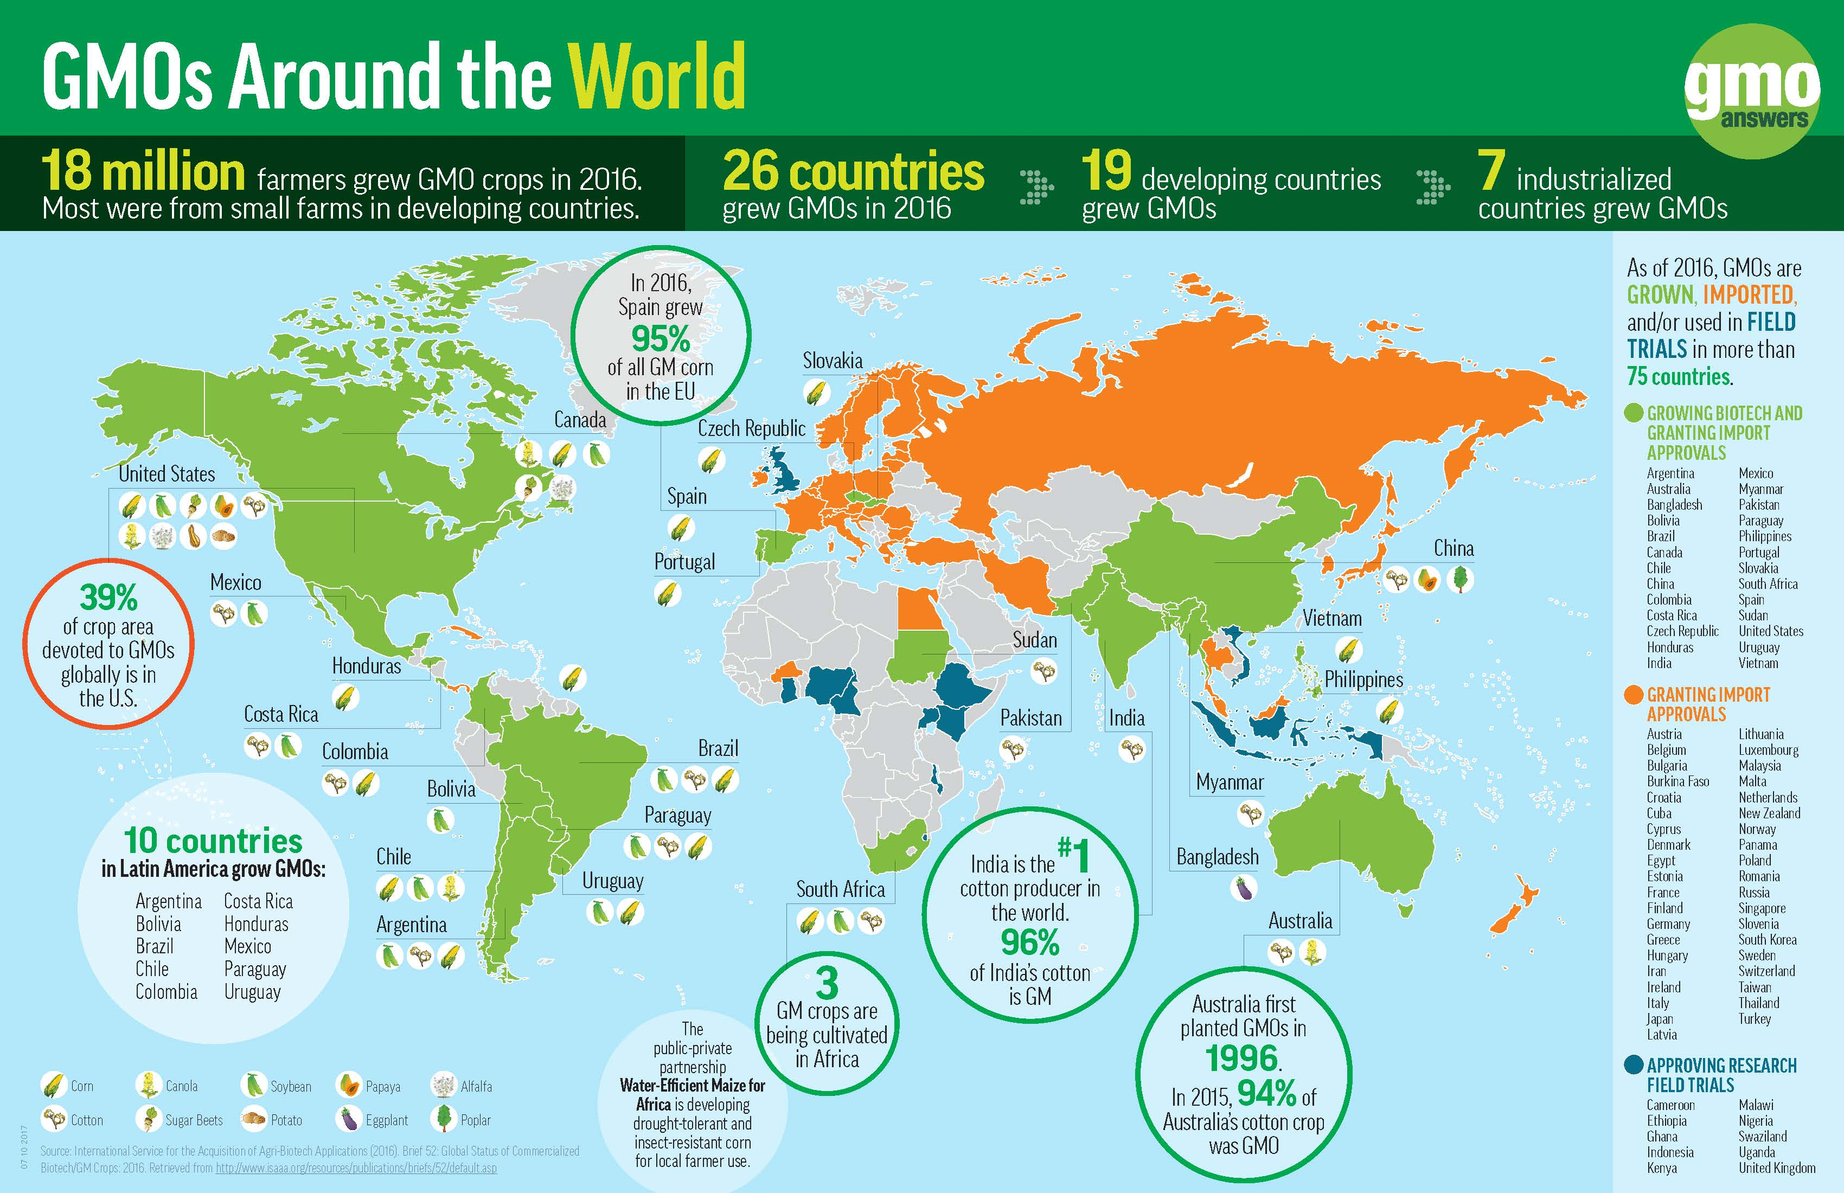
Modern Agriculture – GMOs Globally
GMO crops are grown around the world by approximately 18 million farmers, most of them in developing countries.
In total, more than 75 countries import, grow and/or research GMOs, and in 2016, 26 countries (seven industrial and 19 developing) planted biotech crops.
As of 2016, the top five countries growing GMOs in terms of crop area are the United States, Brazil, Argentina, Canada and India.
Notes:
Cultivating GMO crops has provided significant benefits to farmers globally, including increased yield and lower production costs. Importantly, GMOs also help to alleviate poverty for the millions of resource-poor farmers and farm families around the world (equaling approximately 65 million people total). PG Economics estimates that farmers in developing countries received $3.45 for each dollar invested in genetically engineered crop seeds in 2015. As countries look to expand their domestic GM product pipelines and crop production, even more farmers will have access to improved seeds and the benefits they provide.

Slide 18
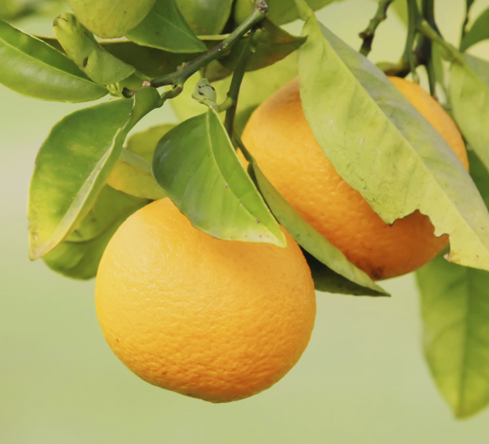

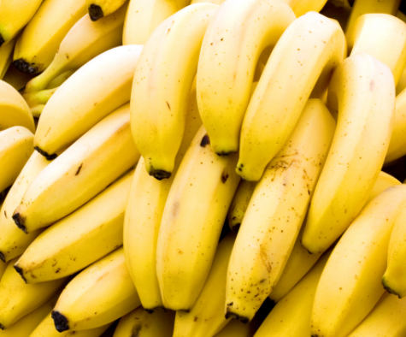

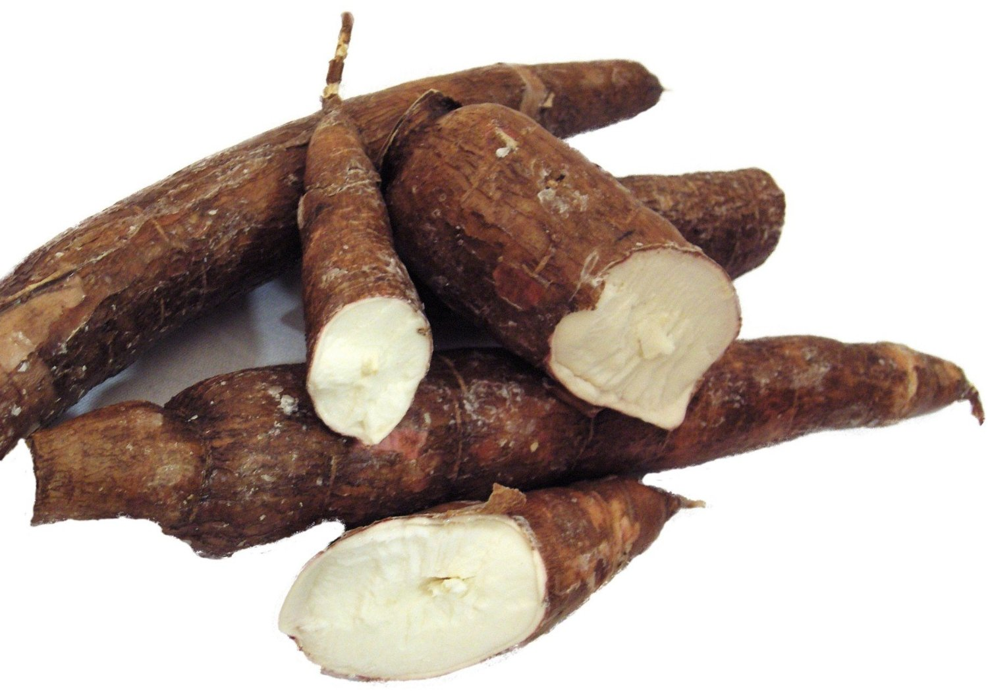
Future of GMOs
Beyond food production, genetic engineering has many applications that benefit us and our planet, including medicine, plant restoration and disease resistance.
Notes:
What does the future of GMOs look like?
Genetic engineering has many applications other than food or the GMO crops currently on the market.
Save our OJ!: GM citrus could help fight citrus greening, a plant disease that is devastating the citrus industry in the U.S. (bottom left)
Healthcare: A GM tobacco plant has been used to develop a treatment for the Ebola virus, and most human insulin already is genetically engineered.
Save East Africa’s bananas!: In eastern Africa, banana Xanthomonas wilt (BXW) disease is considered one of the greatest threats to banana productivity. Genetically-engineered bananas resistant to BXW are saving this staple crop.
Restore extinct plant species: The State University of New York (SUNY) College of Environmental Science and Forestry (ESF) has genetically modified the American Chestnut tree to withstand the blight that has nearly wiped out this iconic hardwood tree in the United States.
Biofortification: The Danforth Plant Science Center is developing BioCassava Plus - more nutritious, higher yielding and more marketable cultivars of cassava, the primary source of calories for 250 million Africans.

Slide 19




Looking for More Information?
Explore: Visit GMOAnswers.com for information and resources on GMOs and biotechnology in a simple, visual and user friendly way.
Ask: Submit a question and have it answered by one of our over 200 independent, volunteer experts.
Engage: Join the conversation by posting a comment and participating in a dialogue with other members of the science community online.
Facebook.com/GMOAnswers
Pinterest.com/GMOAnswers
@GMOAnswers
Youtube.com/GMOAnswers
Notes:
Looking for More Information?
You can visit GMOAnswers.com to learn more about GMOs and ask your questions.
You can also find us on Twitter, Facebook, Pinterest and YouTube

